Slide 1
Perspective Drawing
Also called Linear Perspective
Discovered during the Italian Renaissance
Uses lines to create feeling of depth
Uses a vanishing point
Makes artwork look 3-D
Math!

Slide 2
Renaissance
Began in Italy after the fall of Rome
1400-1600
Artists focused on showing human experience
Michelangelo – Leonardo da Vinci – Brunelleschi
Art, science and literature
Shakespeare, Galileo

Slide 3
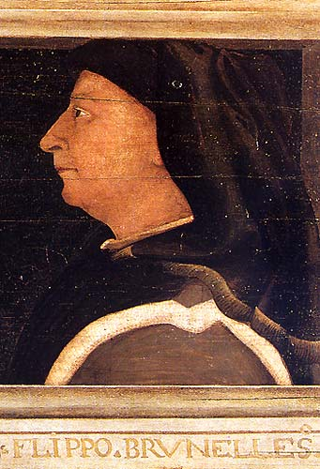
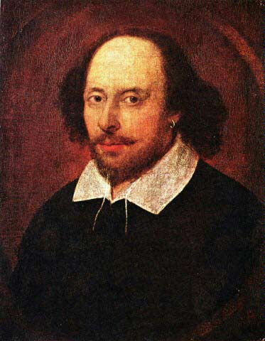
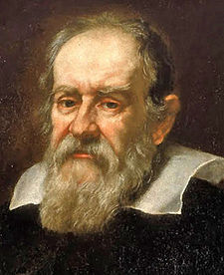
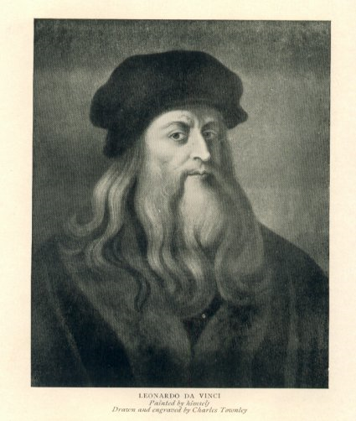

Slide 4
Perspective Vocabulary
Vertical - Horizontal - Parallel
Horizon Line
Vanishing Point
Orthogonal Lines
Face

Slide 5
Student Examples
Looking into a room or hallway

Slide 6
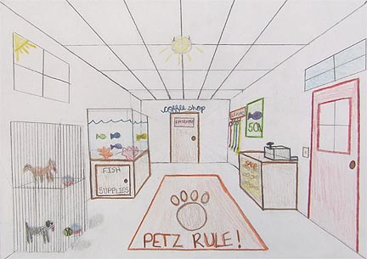

Slide 7
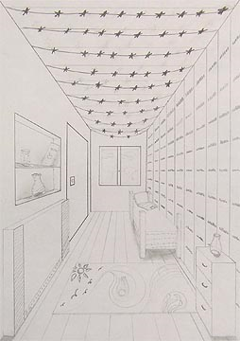

Slide 8
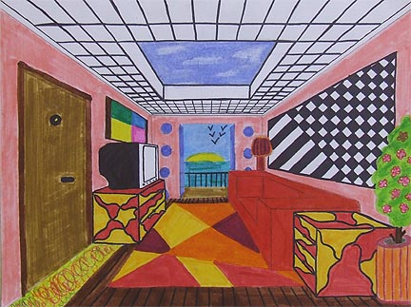

Slide 9
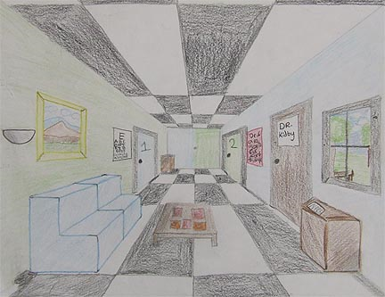

Slide 10
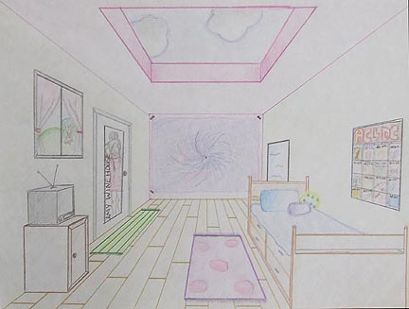

Slide 11
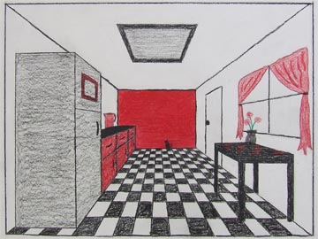

Slide 12
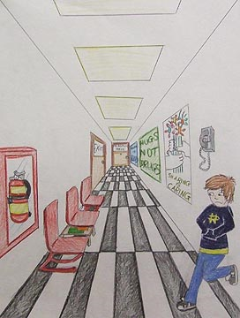

Slide 13
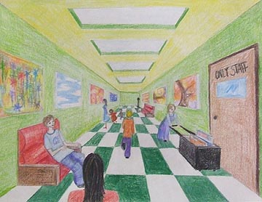

Slide 14
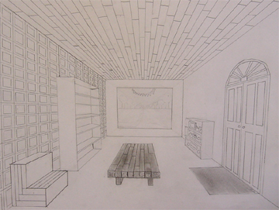

Slide 15
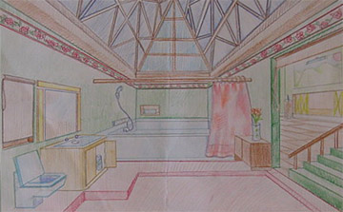

Slide 16
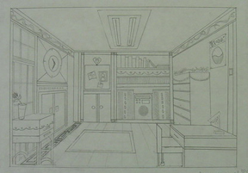

Slide 17
